Slide 1
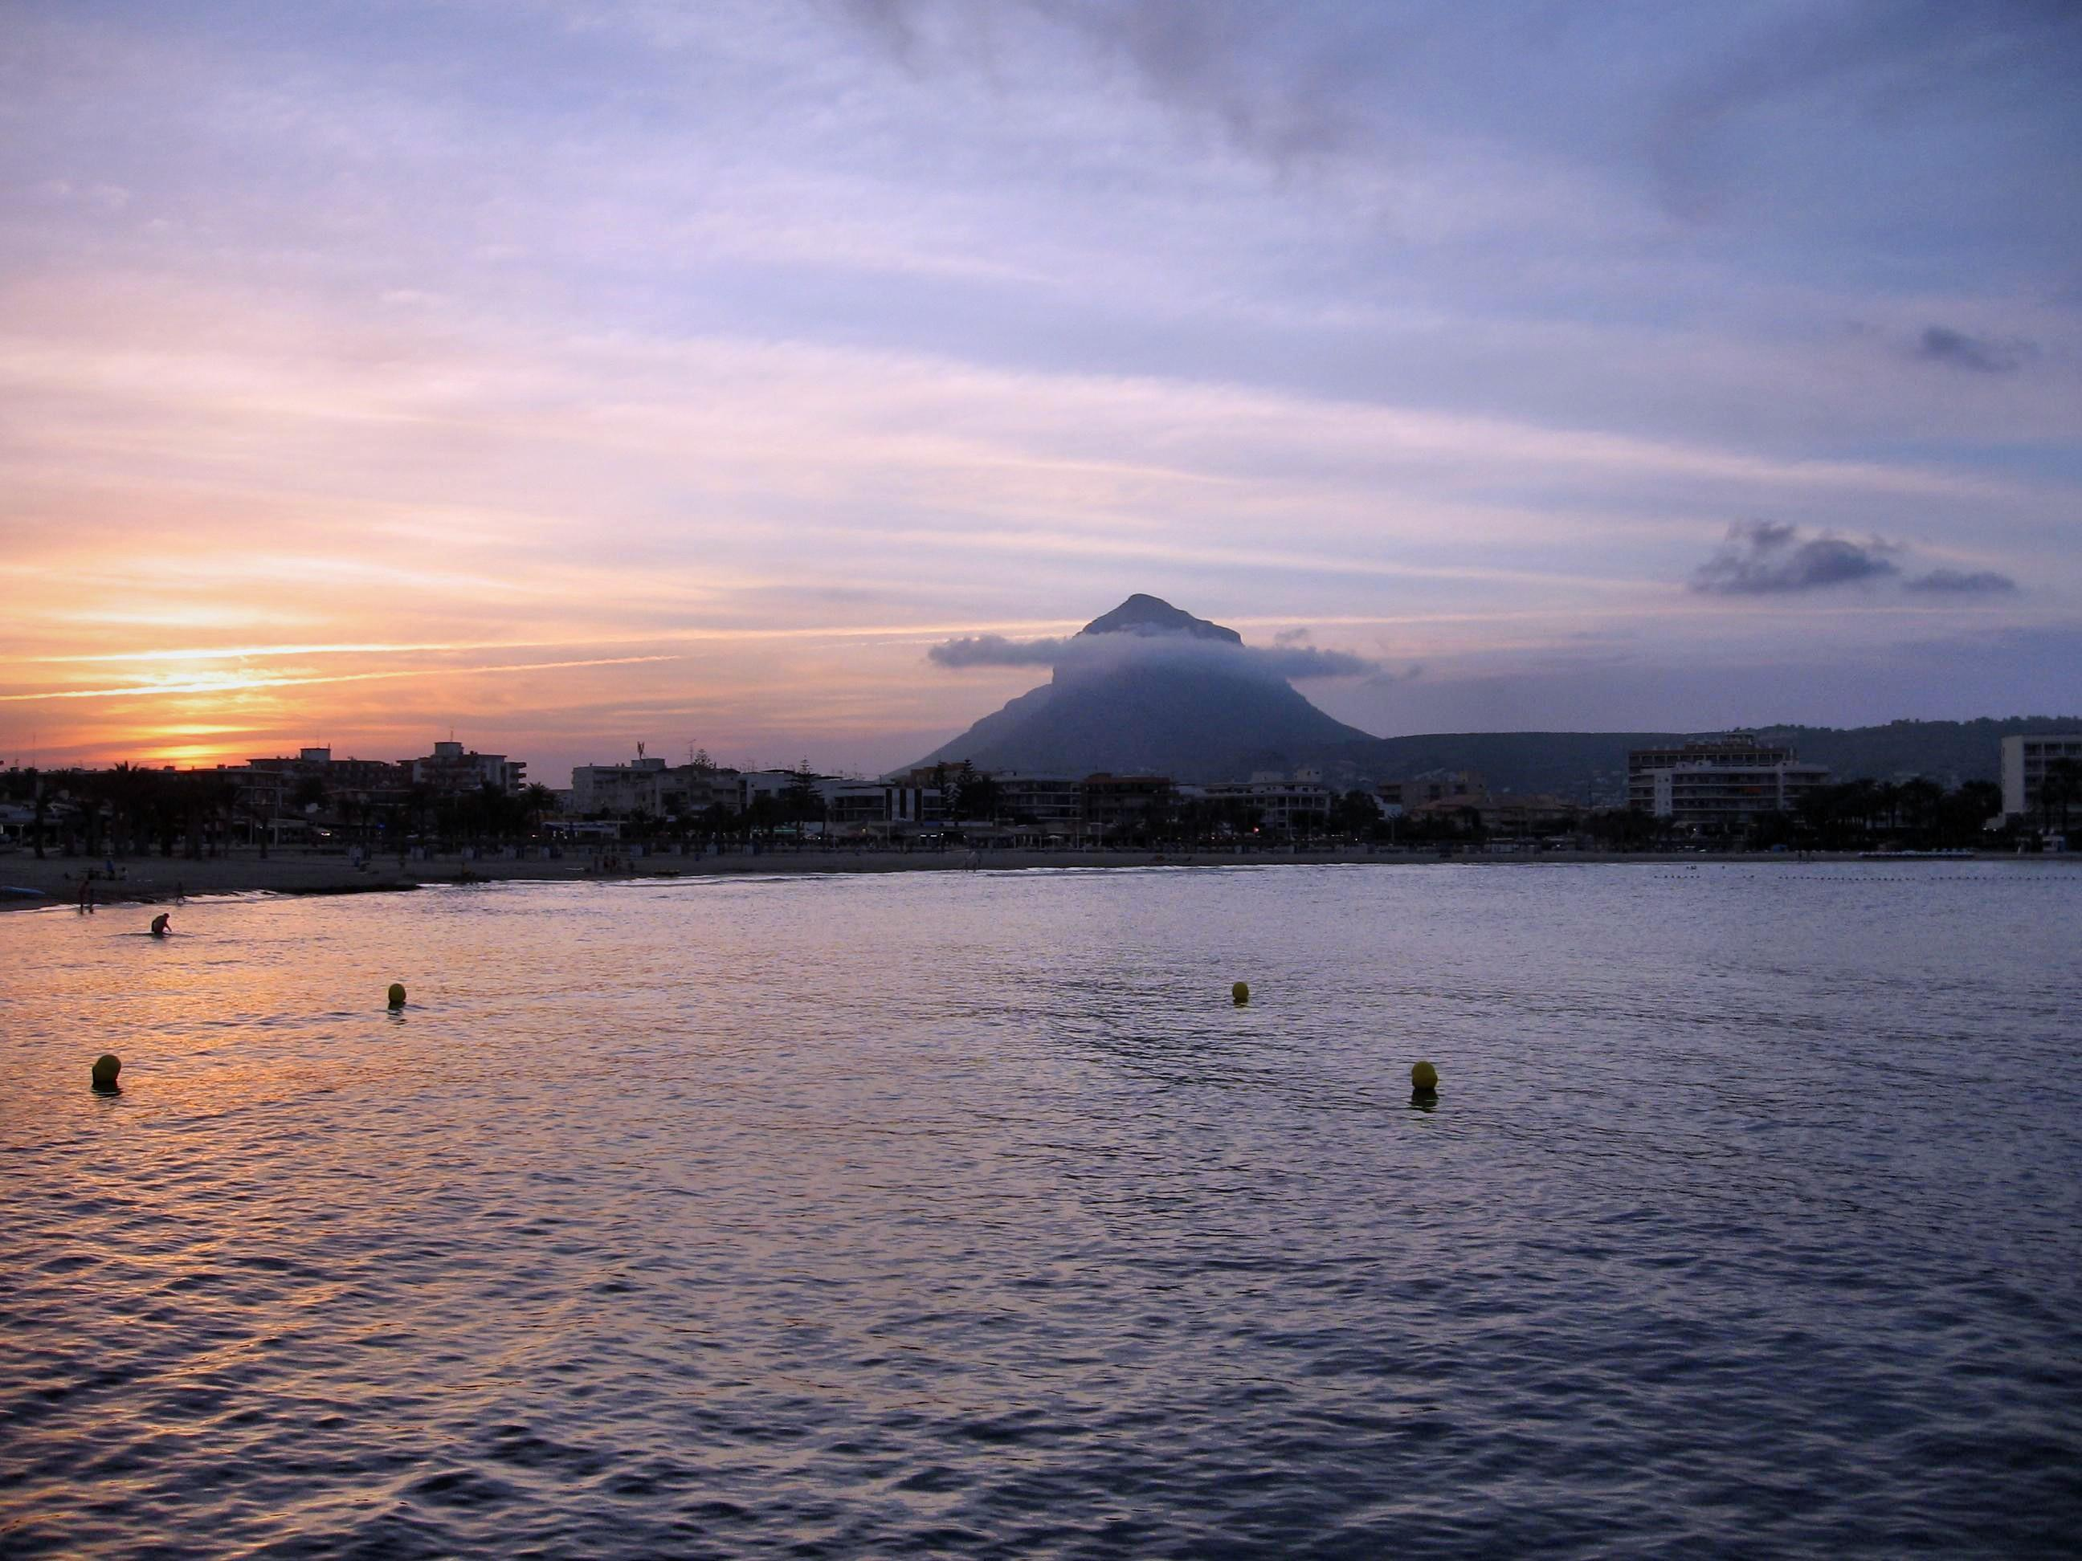
What in the World is Worldliness? John 17:13-19

Slide 2
What in the World is Worldliness? John 17:13-19
Historical understanding:

Slide 3
What in the World is Worldliness? John 17:13-19
Historical understanding:

Slide 4
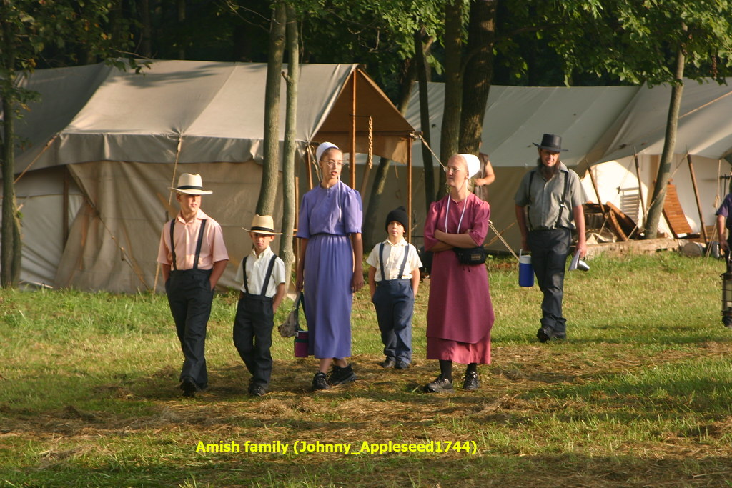
What in the World is Worldliness? John 17:13-19
Historical understanding:

Slide 5
What in the World is Worldliness? John 17:13-19
Historical understanding
Modern equivalent

Slide 6
What in the World is Worldliness? John 17:13-19
Historical understanding
Modern equivalent

Slide 7
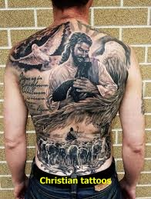
What in the World is Worldliness? John 17:13-19
Historical understanding
Modern equivalent

Slide 8
What in the World is Worldliness? John 17:13-19
Historical understanding
Modern equivalent
What is worldliness?
“Cosmos”

Slide 9
What in the World is Worldliness? John 17:13-19
Historical understanding
Modern equivalent
What is worldliness?
Cosmos = created order

Slide 10
What in the World is Worldliness? John 17:13-19
Historical understanding
Modern equivalent
What is worldliness?
Cosmos = created order
Sinful world

Slide 11
What in the World is Worldliness? John 17:13-19
In the world like Jesus

Slide 12
What in the World is Worldliness? John 17:13-19
In the world like Jesus
Jesus was fully engaged

Slide 13
What in the World is Worldliness? John 17:13-19
In the world like Jesus
Jesus was fully engaged
No isolationism

Slide 14
What in the World is Worldliness? John 17:13-19
In the world like Jesus
Jesus was fully engaged
No isolationism
No closing of eyes to sin

Slide 15
What in the World is Worldliness? John 17:13-19
In the world like Jesus
Jesus was fully engaged
No isolationism
No closing of eyes to sin
Remain alert

Slide 16
What in the World is Worldliness? John 17:13-19
In the world like Jesus
Jesus was fully engaged
Jesus’ divine mission

Slide 17
What in the World is Worldliness? John 17:13-19
In the world like Jesus
Jesus was fully engaged
Jesus’ divine mission
Our mission

Slide 18
What in the World is Worldliness? John 17:13-19
In the world like Jesus
Jesus was fully engaged
Jesus’ divine mission
Our mission
Remain focussed

Slide 19
What in the World is Worldliness? John 17:13-19
In the world like Jesus
Jesus was fully engaged
Jesus’ divine mission
Jesus’ opposition

Slide 20
What in the World is Worldliness? John 17:13-19
In the world like Jesus
Distinctive like Jesus
“They are not of the world, anymore than I am of the world” (vv.14b,16)

Slide 21
What in the World is Worldliness? John 17:13-19
In the world like Jesus
Distinctive like Jesus
The way to genuine joy v.13
“I am coming to you now, but I say these things while I am still in the world, so that they may have the full measure of my joy within them.”

Slide 22
What in the World is Worldliness? John 17:13-19
In the world like Jesus
Distinctive like Jesus
The way to genuine joy v.13
Need for separate origin

Slide 23
What in the World is Worldliness? John 17:13-19
In the world like Jesus
Distinctive like Jesus
The way to genuine joy v.13
Need for separate origin
New mindset

Slide 24
What in the World is Worldliness? John 17:13-19
In the world like Jesus
Distinctive like Jesus
The way to genuine joy v.13
Need for separate origin
New mindset
New Scriptural diet

Slide 25
What in the World is Worldliness? John 17:13-19
In the world like Jesus
Distinctive like Jesus
The way to genuine joy v.13
Need for separate origin
New mindset
New Scriptural diet
God’s word = “the truth!”

Slide 26
What in the World is Worldliness? John 17:13-19
In the world like Jesus
Distinctive like Jesus
The way to genuine joy v.13
Need for separate origin
New mindset
New Scriptural diet
God’s word = “the truth!”
The truth sanctifies

Slide 27
What in the World is Worldliness? John 17:13-19
In the world like Jesus
Distinctive like Jesus
The way to genuine joy v.13
Need for separate origin
New mindset
Obedience to God’s word

Slide 28
What in the World is Worldliness? John 17:13-19
In the world like Jesus
Distinctive like Jesus
The way to genuine joy v.13
Need for separate origin
New mindset
Obedience to God’s word
Related to witness

Slide 29
What in the World is Worldliness? John 17:13-19
In the world like Jesus
Distinctive like Jesus
The way to genuine joy v.13
Need for separate origin
New mindset
Obedience to God’s word
Related to witness
Reaction to others

Slide 30
What in the World is Worldliness? John 17:13-19
In the world like Jesus
Distinctive like Jesus
The way to genuine joy v.13
Need for separate origin
New mindset
Obedience to God’s word
Related to witness
Reaction to others
Response to others

Slide 31
What in the World is Worldliness? John 17:13-19
In the world like Jesus
Distinctive like Jesus
The way to genuine joy v.13
Need for separate origin
New mindset
Obedience to God’s word
In enemy territory

Slide 32
What in the World is Worldliness? John 17:13-19
In the world like Jesus
Distinctive like Jesus
The way to genuine joy v.13
Need for separate origin
New mindset
Obedience to God’s word
In enemy territory
Varied applications

